Slide 1
Hand Harmony- Sign Language Detection
By Dilpreet Kaur

Slide 2
Introduction
The communication gap faced by people with hearing and speech impairments.
It helps translate gestures into text for better communication.
Then it displays the predicted letter or word on the screen.
The system detects the hand, processes the image, and uses a trained deep learning model to figure out which sign it is.

Slide 3
Table Of Content
Motivation
Project Objective
Technologies Used
Data Collection Module
Model Architecture
Results
Normalized schema
System Design
Accuracy
Real-Time Detection
Challenges
Future Improvements
Conclusion

Slide 4
Motivation
Sign language is used by people who are deaf or hard of hearing.
This system can help bridge the communication gap for non-signers.
Can be used in schools, hospitals, customer service, and more

Slide 5
Project Objective
Sign language is used by people who are deaf or hard of hearing.
This system can help bridge the communication gap for non-signers.
Can be used in schools, hospitals, customer service, and more
Detect hand gestures from webcam
Display the predicted letter in real time like hello, please, thank you, sorry, ok etc…..

Slide 6
Technologies Used
Python – The programming language used to build the system
OpenCV – Used to access the webcam and process the video frames
TensorFlow/Keras – To train and run a deep learning model
NumPy, Matplotlib – For data handling and visualizing results
Jupyter Notebook – For writing and testing the code interactively

Slide 7
Data Collection Module
File: datacollection.py
Starts webcam and tracks hands.
Crops hand region with padding and resizes it to 300x300 px.
Saves clean images when "s" key is pressed.
Saves each image under a specific folder (e.g., data/call).

Slide 8
Model Architecture
The model is a Convolutional Neural Network (CNN) – a type of deep learning model used for image classification.
The CNN learns to detect edges, shapes, and patterns in hand gestures.
During training:
Images are passed through the model
The model adjusts itself to correctly predict the label

Slide 9
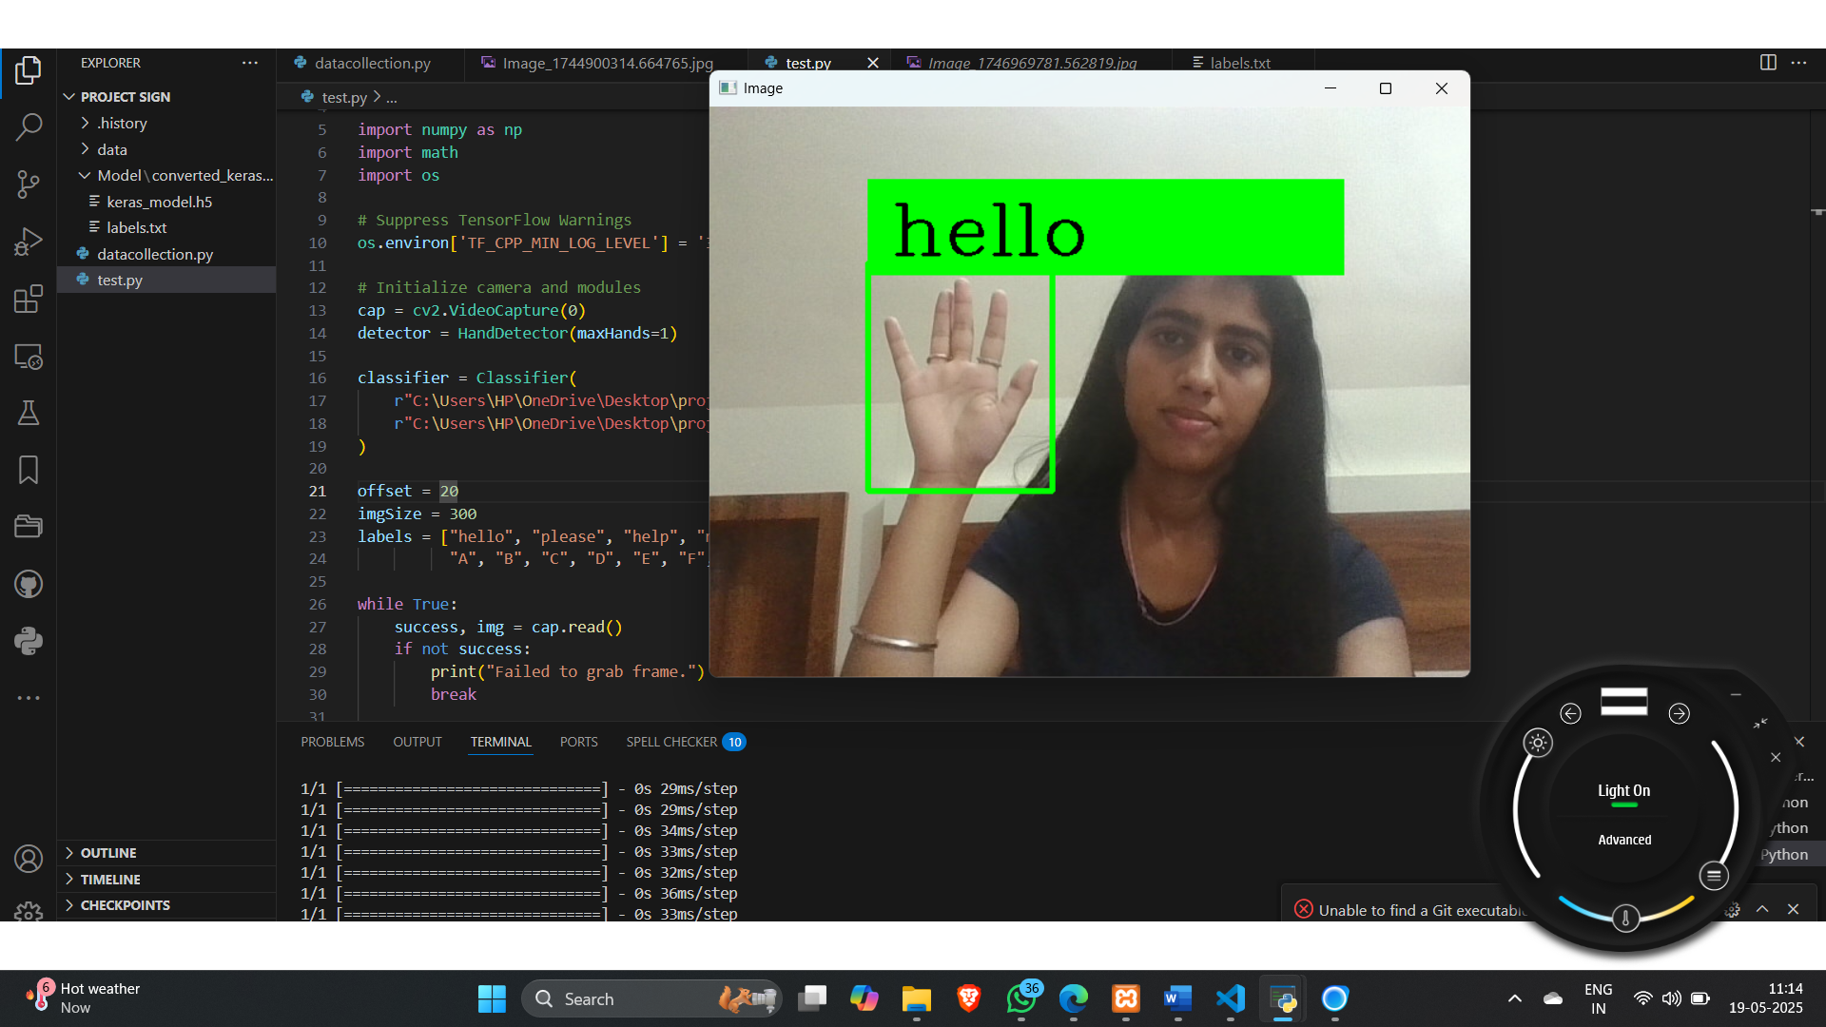
Results

Slide 10
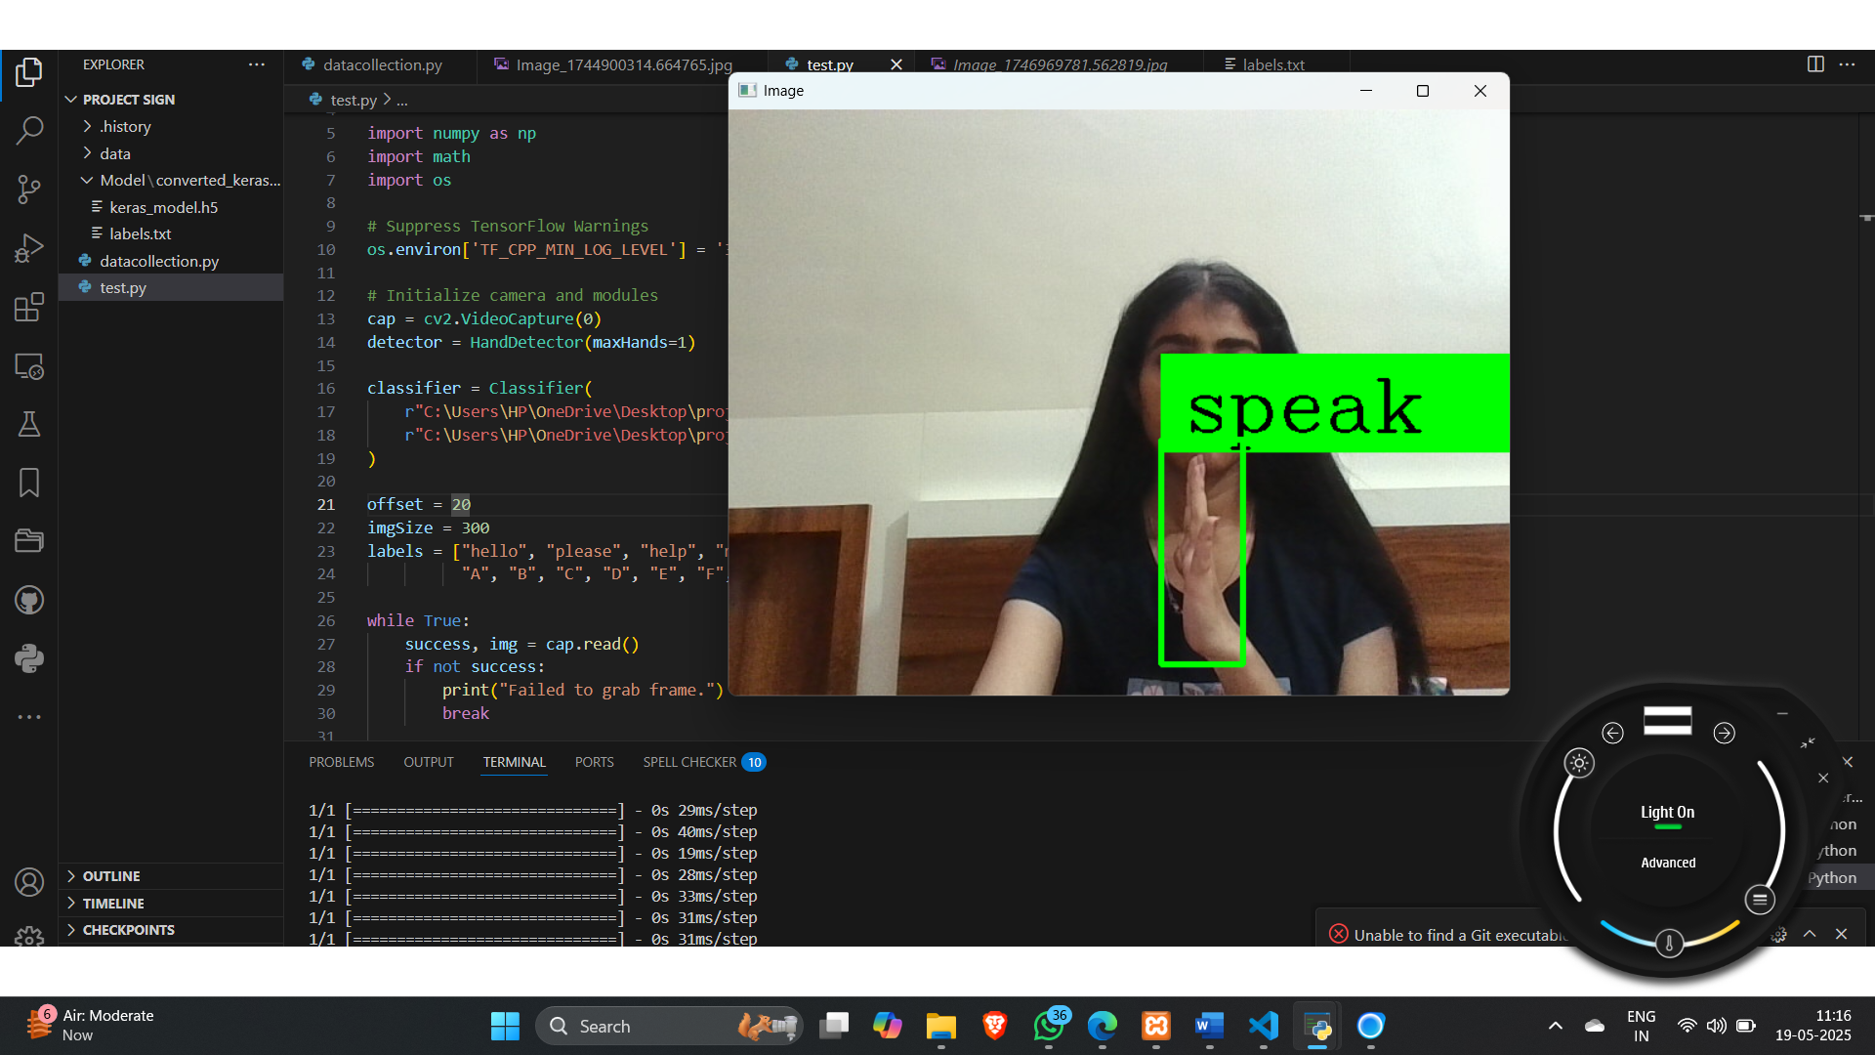
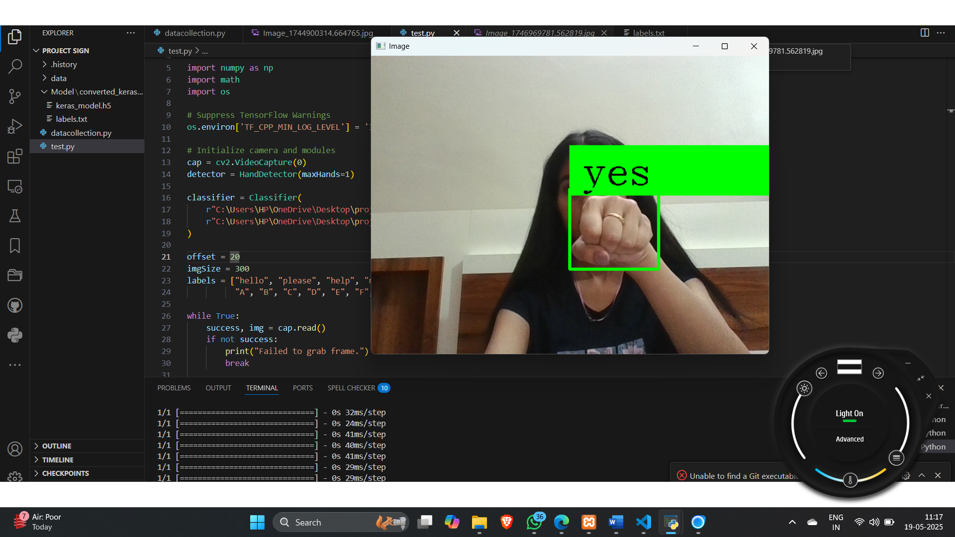

Slide 11
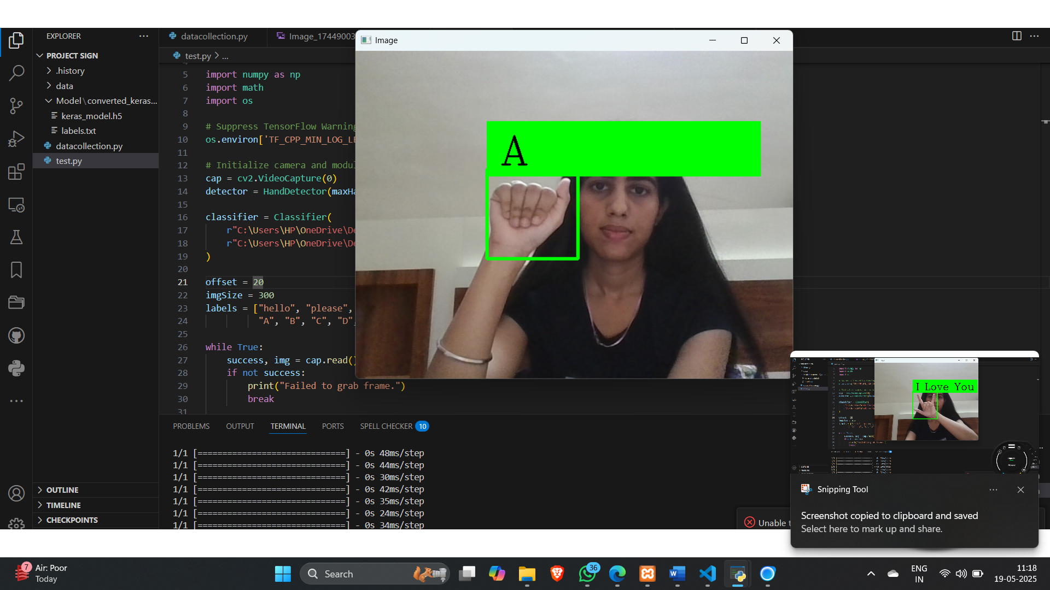
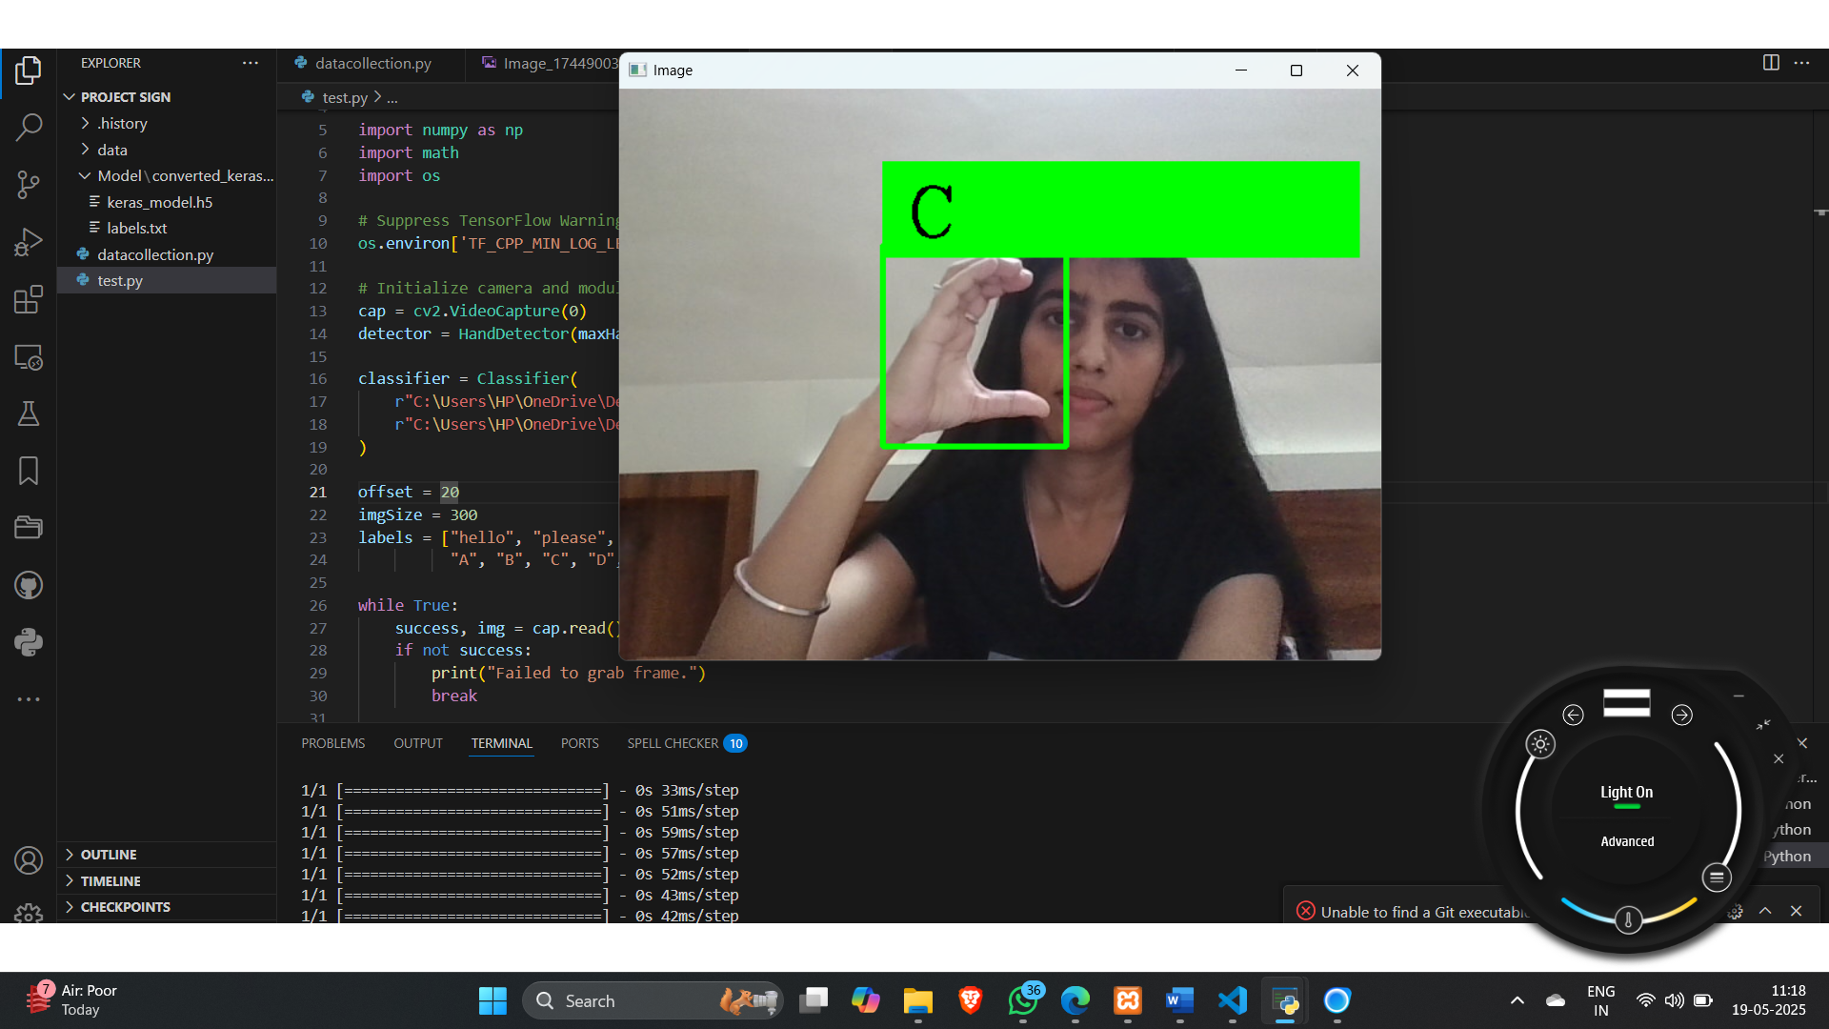

Slide 12
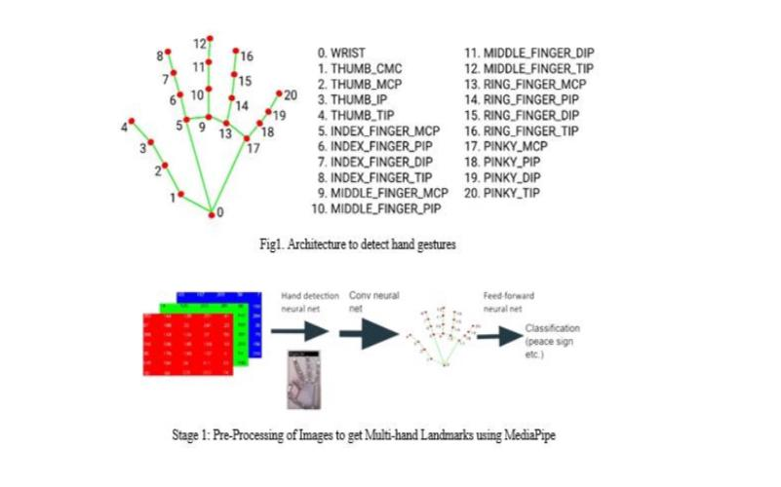
Normalized schema

Slide 13
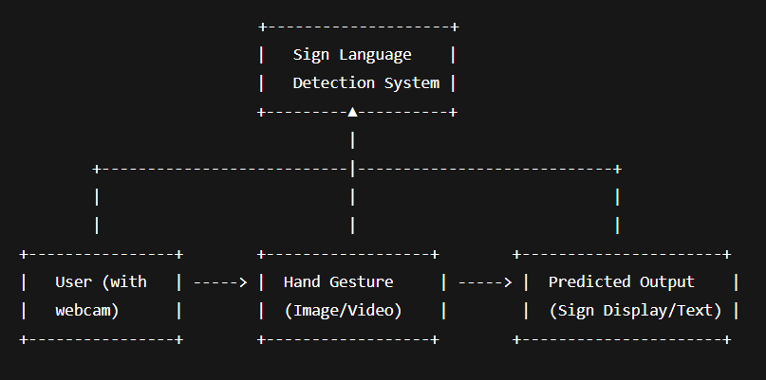
System Design

Slide 14
Accuracy
The project achieves high accuracy (like 80%+ depending on the dataset and training time).
You can also show graphs like loss and accuracy over time to prove it worked well.

Slide 15
Real-Time Detection
You can use your webcam to show hand signs in front of the camera.
The program will detect the sign in real time and show the predicted letter or word.

Slide 16
Challenges
Different lighting conditions
Hand sizes and skin tones
Background clutter
Need for lots of data for high accuracy

Slide 17
Future Improvements
Add full words and sentences, not just letters
Support for multiple sign languages
Voice output for detected signs
Mobile or web app integration

Slide 18
Conclusion
Successfully detects and classifies hand signs using a CNN model.
Works in real-time using a webcam and OpenCV.
Achieves high accuracy on a well-prepared dataset.
Helps improve accessibility and inclusiveness in communication.

Slide 19
Thank You

